Slide 1
Supportlytics
Data-Driven Optimization of IT Support Team Performance Using Analytics
Milestone 1 Presentation
Presented by: Srikanth K

Slide 2






Project Overview
Problem: The objective of this project is to analyze IT support ticket data to identify key performance trends, optimize resolution times, and enhance service efficiency through data analysis and visualization.
Long resolution time
High ticket backlog
Repeated customer issues
Uneven workload
Reduced customer satisfaction
Project Modules
Workflow:
Dataset → Cleaning → Feature Engineering → EDA → Visualization → Insights → Recommendations
Objective: Optimize IT support performance using data analytics to reduce resolution time, stabilize workload, and raise satisfaction.
Data Acquisition
Data Cleaning
Feature Engineering
Exploratory Data Analysis
Performance Analysis
Dashboard

Slide 3

Objectives, KPIs & Workflow
1
2
Key Performance Indicators
Average Resolution Time (ART)
First Response Time (FRT)
Ticket Volume
Priority Distribution
Customer Satisfaction Score (CSAT)
SLA Compliance
Analyze customer support tickets
Improve support efficiency
Discover patterns and root causes across channels and regions.
Streamline triage and routing to reduce backlog.
3
4
KPIs will be tracked in the dashboard and fed back into team-level reports for continuous improvement.
Reduce resolution time
Identify recurring issues
Target high-impact interventions and automation.
Prioritize fixes and knowledge-base updates.
5
Enable better decisions
Deliver dashboards and actionable recommendations.

Slide 4
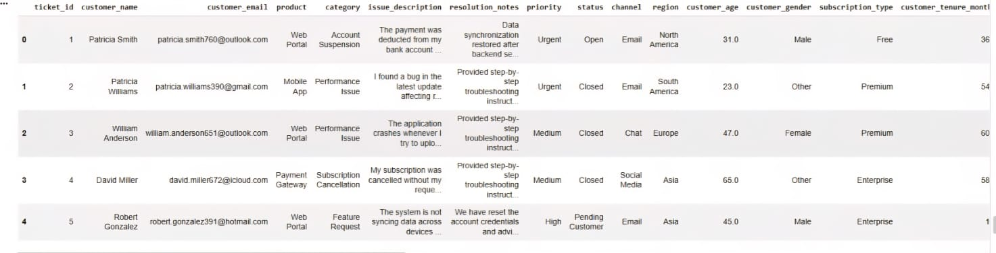
Dataset Overview
Customer Support Ticket Dataset
Important Columns
Ticket ID
Category
Priority
Status
Channel
Region
Resolution Time
Customer Satisfaction
import pandas as pd
df = pd.read_csv("customer_sp_ticket.csv")
df.shape
Observation: The dataset contains sufficient records for meaningful business analytics and model training.
Rows
Columns
Format
Memory
200,000
30
CSV
46 MB

Slide 5

Schema, Data Types & Missing Values
Diagnostic Code
Data Types
df.info()
df.isnull().sum()
Integer, Float, Object (string), Datetime
Only the Browser column requires imputation—no systemic data loss detected.
Schema Validation
Column-level checks and type enforcement applied.
Missing Values
Browser column contains nulls; other critical columns are complete.

Slide 6
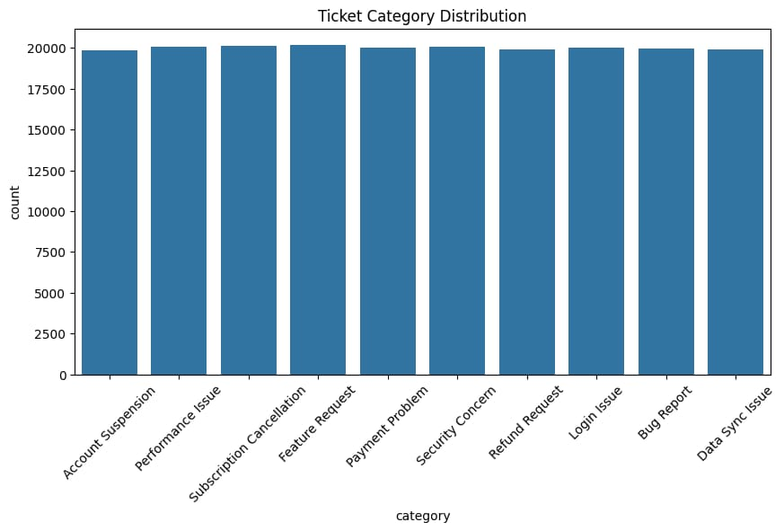
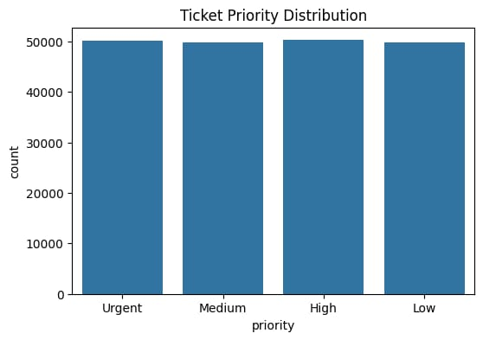
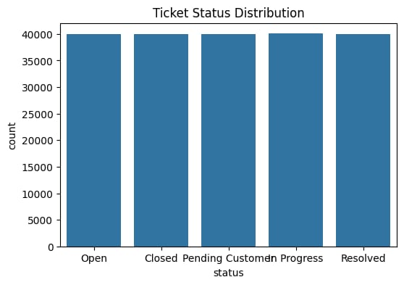
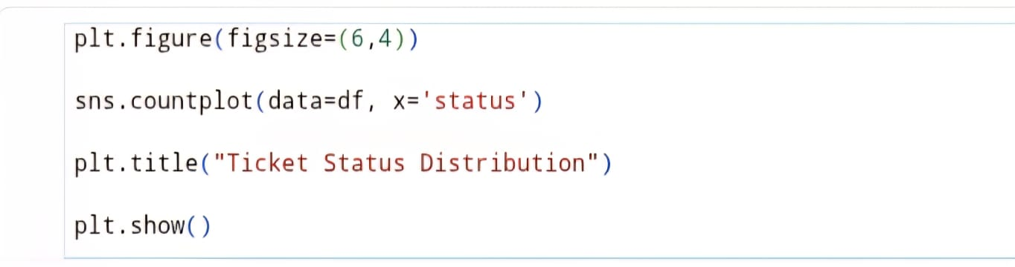
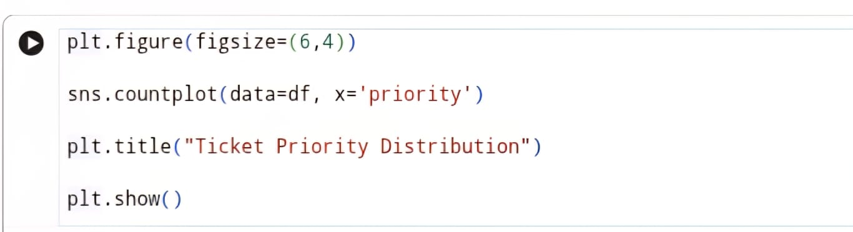
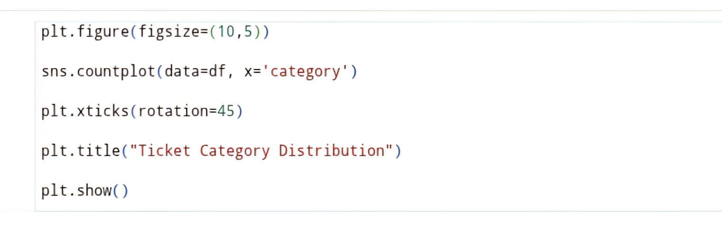
Initial Ticket Distribution

Slide 7
Data Cleaning
Before → After
Handle Missing Values
Before: inconsistent types, nulls in Browser, duplicate rows.
After: clean schema, datetime normalized, Browser imputed, duplicates removed.
Impute Browser from user-agent or mark as 'unknown' where appropriate.
df.isnull().sum() df.dropna() pd.to_datetime(df['created_at'])
Convert Date Columns
Ensure consistent timezone and datetime dtype.
Validate Duplicates
Identify and remove exact duplicate ticket records.
Normalize Text
Standardize category and channel labels for grouping.

Slide 8

Feature Engineering
Priority Mapping
Low = 1 · Medium = 2 · High = 3 · Urgent = 4
Resolution_Duration
Priority_Score
Type
# Example
priority_map = {'Low':1,'Medium':2,'High':3,'Urgent':4}
df['Priority_Score'] = df['Priority'].map(priority_map)
Derived: Incident, Request, Problem — used for escalation logic.
Computed difference between resolved_at and created_at (minutes/hours).
Numeric encoding to weight tickets for routing and SLA checks.
Feature engineering enhances model inputs and KPI calculations for consistent monitoring.

Slide 9
Processed Dataset
The processed dataset has been exported and stored for downstream analysis, visualization, and model development.
df.to_csv("customer_support_tickets.csv", index=False)
Benefits
Reusable — consistent format for future analyses
Clean — validated types and handled nulls
Analytics-ready — features and KPIs available
Rows
Columns
Status
200,000
33
Processed Dataset Ready

Slide 10
Milestone 1 Deliverables
✔ Dataset Loaded
Next Milestone
Exploratory Data Analysis (detailed segment & trend analysis)
Advanced Visualization & Performance Metrics
Dashboard Development for operational monitoring
✔ Schema Explored
✔ Missing Values Handled
✔ Feature Engineering Completed
Thank you
✔ Processed Dataset Saved
Questions?
✔ Data Dictionary Prepared

